Slide 1
Post Service Officer (PSO) Duties
Belinda Boldoe, Department Service Officer

Slide 2
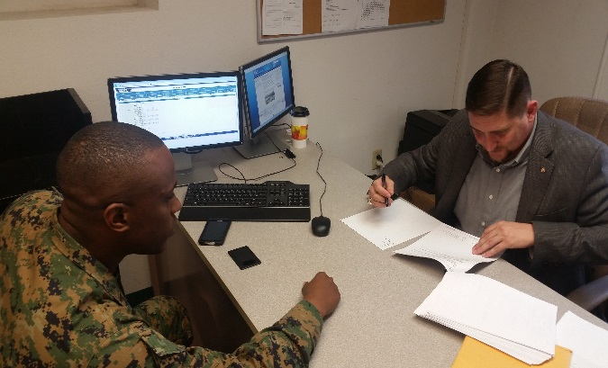
What is a Post Service Officer?

Slide 3
Post Service Officer VFW By-Laws
VFW's Congressional Charter, National Bylaws, Manual of Procedure and Ritual
VFW Podium Edition (By-Laws)
Section 218 (12), VFW Manual of Procedure”
The VFW Manual of Procedure, Sec. 218, mandates that each Post Service Officer have the latest edition of the Guide for Post Service Officers.

Slide 4
Guide for Post Service Officers
Perform duties in accordance with the instructions contained in the VFW Guide for Post Service Officers under the general supervision of the Post Commander.
VFW National Veterans Service publishes the “VFW GUIDE FOR POST SERVICE OFFICERS” which provides a quick reference concerning the duties and responsibilities of the position and VA benefits to Post Service Officers.
The current edition of the VFW Guide can be found on the VFW website under VA Claims & Separation Benefits
https://www.vfw.org/assistance/va-claims-separation-benefits

Slide 5
What is a Claim SharK
A Claim Shark is an individual or company that “assists” or “consults” veterans with VA claims even though they are not accredited with VA
Many of these companies charge fees for their services, sometimes totaling in the tens of thousands of dollars for services that veterans can receive from you FOR FREE
These companies have used the pandemic to their advantage, offering fully remote “assistance” and easy to access “one click away buttons” in order to capitalize on the reduced resources available due to VA closures
They cannot access VBMS or other VA systems so they often ask for the veteran’s Ebenefits password so they can “review the record

Slide 6
What is VFW Mission
This past year, VFW has taken several steps to help prevent these practices by VA and VSOs such as messaging, testimony to congress, and reporting these practices to the proper authorities as they are discovered
VFW is working with VA and congress to have legislation passed to enforce accreditation standards and provide penalties for those who are not in compliance
VFW is working with VBA, OGC, CFPB, DOJ and other agencies to identify unlawful and predatory practices for purposes of enforcement

Slide 7
What is a Post Service Officer?
PSOs are local ambassadors of the Veterans of Foreign Wars; each VFW Post should have an appointed PSO.
PSOs serve as a conduit to critical programs and services in the community but they are not accredited representatives
A resource or information center for the members, veterans, and the families.

Slide 8
What is a Post Service Officer (PSO)
PSOs serve as a link between the veteran, the dependents, and the accredited VFW Representative
PSOs deliver information about veterans’ benefits to those who cannot come to them, whether in community centers, nursing homes, places of worship, Vet Centers, or just around town
PSOs are able to find information on the state and the local benefits
The knowledge PSOs carry with them can help veterans and their survivors obtain the benefits they have earned

Slide 9
Post Service Officers
Duties and Responsibilities

Slide 10
The Post Service Officer
Duties and Responsibilities
Direct individuals seeking federal benefits assistance to the Department Service Officer or Accredited Representatives for claims assistance.
Provide information on ancillary benefits available from the VA for veterans, spouses or survivors.
Know and inform veterans of services available in the local community or state.

Slide 11
The Post Service Officer
Duties and Responsibilities
Will perform their duties under the supervision of the Post and District Commanders.
PSOs will not identify themself as an accredited representative or act as a representative for the claimant before VA.
Assist Veterans and survivors free of charge; under no circumstances, shall they request, demand or accept cash or any other form of payment for such assistance, etc.

Slide 12
The Post Service Officer
Code of Conduct
Shall not refuse to assist any Veteran or survivor because they do not feel the Veteran or survivor is eligible for the benefit sought. The Department Service Officer or an accredited Representatives will make the final decision as to whether the VFW will provide representation in all cases.
Shall assist members of the Post, their widows and orphans and other Veterans in obtaining rightful benefits from the federal and state governments.
Will only release confidential information, to include address, phone number, or any other personal information to an accredited VFW representatives.

Slide 13
The Post Service Officer
Duties and Responsibilities
The services available in the local community or state to include:
Employment opportunities
Food Banks
Education & Employment
Disaster Assistance
Healthcare & Health Clinics
Mental Health Programs
Homeless Shelters & Assistive Agencies

Slide 14
The Post Service Officer
Duties and Responsibilities
Know and provide information on:
Compensation & Pension (Non-Service Connected & Survivors)
Education (GI Bill, VR&E, DEA)
Death & Burial
Adaptive Housing & Vehicle Grants
Aid & Attendance or Nursing Care
Family Caregiver Program
VA Healthcare (VAMC, CBOC or Community Care)
Community Resource & Referral Centers (CRRC)
Vet Centers (Community Engagement & Mental Health Services)
Some sources of assistance will be specific to veterans, while others may benefit anyone in the community

Slide 15
All accredited VFW GA Representatives are employed by the Georgia Department of Veterans Services (GDVS)
The Director, NVS, is the National Certifying Officer and shall certify the Application for Accreditation as a Service Organization Representative to the VA General Counsel.
Post Service Officer Duties

Slide 16
How to Verify Accreditation of an Accredited Representative
A searchable list of accredited VSO representatives, agents, and attorneys is available at the VA Office of General Council’s website:
http://www.va.gov/ogc/apps/accreditation/index.asp

Slide 17
Department Service Officer
VFW GA Department Service Officer
(DSO) - Belinda Boldoe
Email Address:
Belinda.Boldoe@va.gov (work)
Belinda.Boldoe@georgiavfw.org
Phone Number:
404.983.3270 (Cell)
404.929.5345 (Work)

Slide 18
Questions?

